Slide 1
1.2
Peak Cooling Load
peak
Concept and Design Basis
Visual lecture deck · ~15 minutes
Big idea: design capacity follows the worst simultaneous heat gain — not the average hour.
Notes:
Timing: 1 minute. Open with the load curve. Tell students that HVAC sizing is not based on average comfort; it is based on whether the system can keep up at the worst operating hour. The red dot is the design problem.

Slide 2
A room warms up when heat enters faster than the system removes it
Use a simple balance: heat gain versus cooling capacity.
Design rule
heat gain
cooling removal
Cooling capacity ≥ peak heat gain
conditioned space
If this is true at peak, every lower-load hour is automatically covered.
Notes:
Timing: 1.5 minutes. Explain the room as a control volume. Heat enters from several sources. The AC system must remove heat at the same or higher rate. If not, temperature rises. This is the core of peak load design.

Slide 3
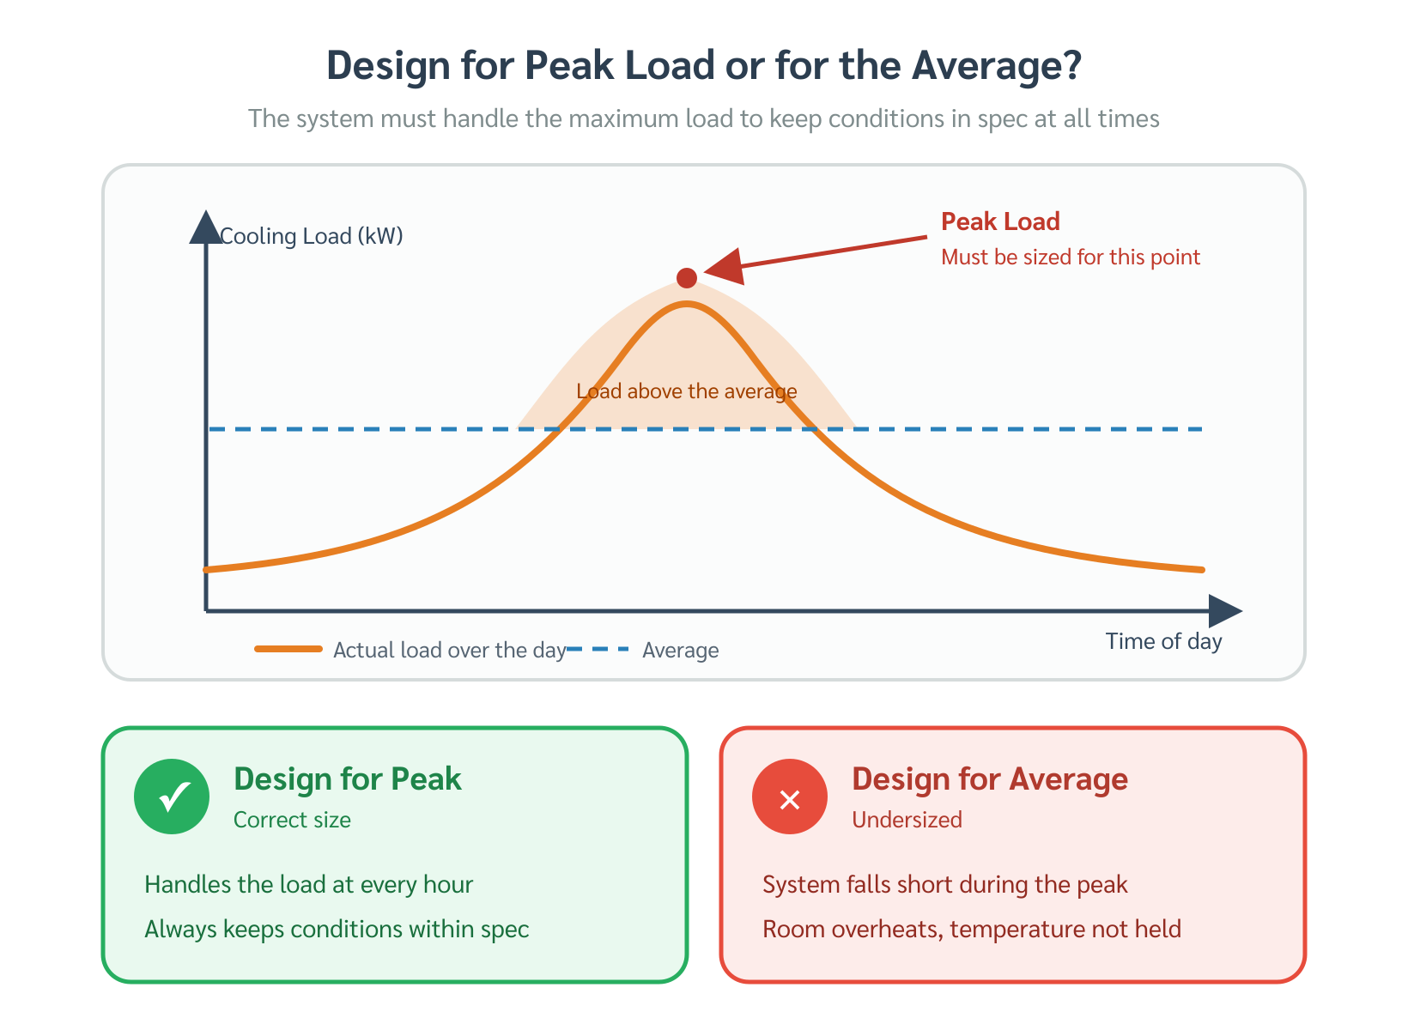
Peak cooling load is the maximum simultaneous heat gain
A daily profile converts a moving problem into one design hour.
TA_YK original figure inserted for review
load
1
design peak
Not constant
Outdoor temperature, solar position, occupancy, lighting, and equipment schedules keep changing.
time
08
12
15
18
Notes:
Timing: 1.5 minutes. Walk along the curve. Heat gain changes throughout the day. The design task is to find the highest total simultaneous load during normal operation. Explain that this is why the next chapters calculate loads hour by hour.

Slide 4
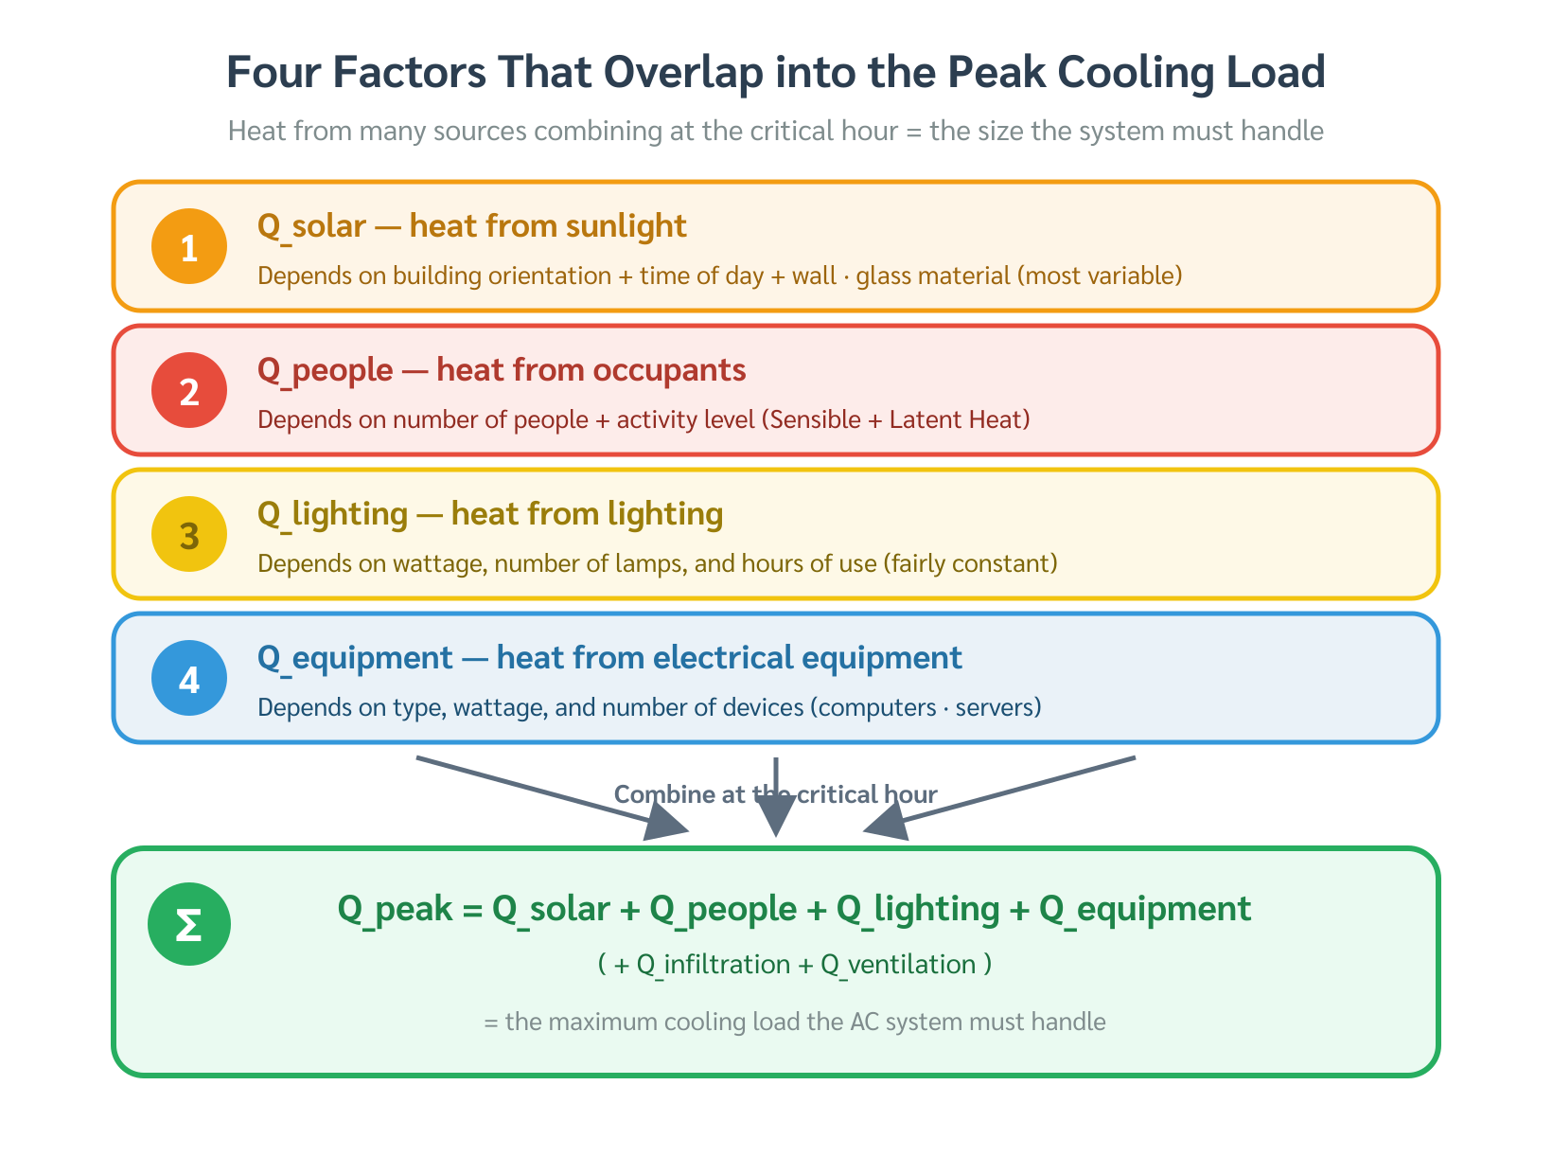
Total load is built from three families of heat gain
Use categories before equations.
TA_YK original figure inserted for review
External
Internal
Ventilation
solar + envelope
conduction + lag
people + lights
+ equipment
fresh air +
infiltration
Notes:
Timing: 1.5 minutes. Keep this slide conceptual. The total load is not one thing; it is a sum of families. External load comes through the building skin, internal load is generated by use, and ventilation/infiltration bring hot humid outdoor air into the space.

Slide 5
Envelope heat gain can arrive hours after the sun hits the building
Thermal lag shifts the load peak into the afternoon.
solar input now
heat release later
indoor space
wall / roof
thermal mass
Typical lag for massive concrete elements: about 2–6 hours
Notes:
Timing: 1.5 minutes. Tell the story of stored heat. The sun does not instantly become room load. Walls and roofs absorb energy and release it later. This explains why peak load can happen after solar noon.

Slide 6
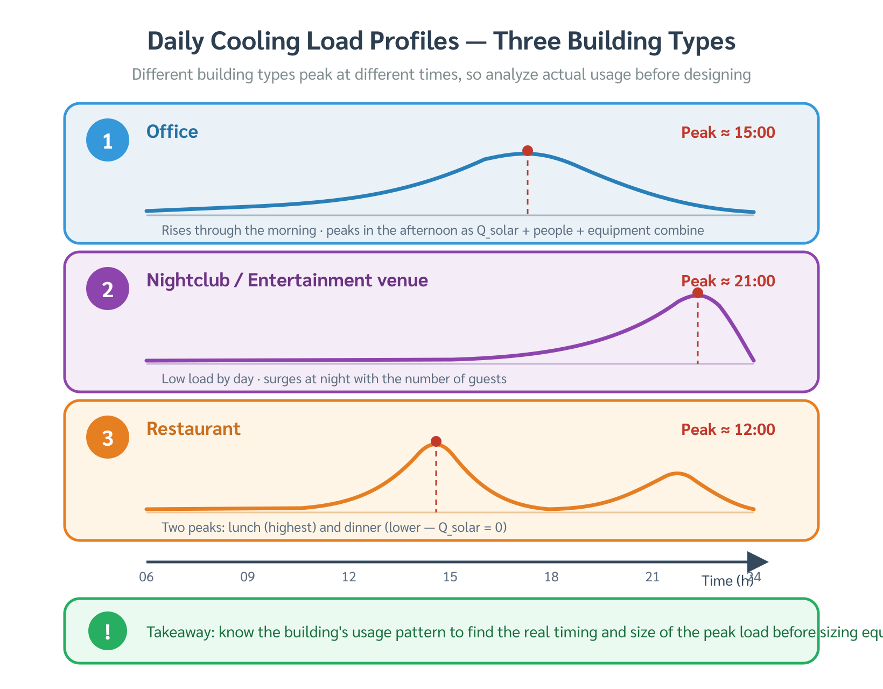
Office buildings often peak at 15:00–16:00
design hour
West solar gain, thermal lag, and internal gains overlap.
TA_YK original figure inserted for review
envelope lag
west façade solar
occupants + lighting + equipment
08:00
12:00
15:00–16:00
18:00
The peak is a coincidence of sources, not just the hottest outdoor temperature.
Notes:
Timing: 1.5 minutes. Point to the timeline. In an office, by mid-afternoon the west-facing glass, delayed envelope heat, and accumulated internal gains combine. That simultaneous overlap gives the design hour.

Slide 7
A nightclub peaks at night because the use pattern changes the load
Peak time follows dominant heat sources.
21:00–22:00
solar gain = 0
dominant load: people + entertainment lighting + latent heat
office: solar + internal
nightclub: internal + latent
Notes:
Timing: 1.5 minutes. Contrast with the office slide. A nightclub has no solar load at peak, but has high occupant density, activity, and lighting. This is why the engineer cannot use one standard peak hour for all buildings.

Slide 8
Wrong capacity creates two different failure modes
Both undersizing and oversizing are engineering mistakes.
Undersized
Oversized
Runs continuously but cannot hold setpoint at peak.
Satisfies thermostat too quickly and short-cycles.
Symptom: room gets warmer on the hottest or busiest hours.
Symptom: cool but sticky, poor dehumidification, wasted energy.
Notes:
Timing: 2 minutes. Spend a little more time here because this is practically important. Undersized systems are obvious at peak. Oversized systems are less intuitive: they may meet temperature but fail humidity because coils do not run long enough to remove moisture.

Slide 9
Peak load calculation is a structured workflow
Before equipment selection, calculate the hourly total.
1
2
3
4
5
6
Survey
Design conditions
Component loads
Hourly totals
Find maximum
Select equipment
Do not size equipment from rules of thumb when actual survey and load data are available.
Notes:
Timing: 1.5 minutes. Use this as the transition from concept to method. The workflow begins with survey data, then design weather, then heat gain components hour by hour. The equipment is selected only after the maximum total is found.

Slide 10
Quick check before moving on
1
Why is peak load not always at noon?
2
Why can an oversized system feel “cold but sticky”?
3
Which load family dominates a full nightclub?
4
What data must come before load calculation?
Next: building survey and load inputs
Notes:
Timing: 1.5 minutes. Use these as oral questions. Do not answer immediately. Let students connect the concepts: thermal lag, short cycling, occupant/lighting latent load, and survey data. Close by saying the next step is learning how to collect reliable load-calculation inputs.

